Slide 1
 |  | Are the methods algebraically equivalent? |  |  |  |  |  | Do the methods give the same prediction about coexistence?
 |  | NFD | L-V model | Sensitivity | TCR | MCR |  | NFD | L-V model | Sensitivity | TCR | MCR
NFD: frequency dependency slope |  |  | N | N | N | N |  |  | Y | Y | Y
L-V: Lotka-Volterra model fitting (α) |  |  |  | Y | Y | Y |  |  |  | Y | Y
Sensitivity: (S_{i}) |  |  |  |  | Y | Y |  |  |  |  | Y
TCR: Tilman’s consumer-resource model |  |  |  |  |  | - |  |  |  |  |  | -
MCR: MacArthur’s consumer-resource model

Slide 2
Decision steps: | 1: Does the method yield estimates of ND and RFD compatible with Chesson’s inequality? | no |  | yes | yes | yes | yes
 | 2: Do you know the factors that govern population dynamics? | no |  | no | no | yes | yes
 | 2: How will empirical data be obtained? | experimental or observational |  | experimental or observational | experimental | experimental | experimental
 | 3: Can you have monocultures? | no |  | yes | yes | yes | yes
 | 4: Can you assume ≥ 1 species is at steady-state? | no |  | no | yes | no | no
 | 5: Need a method for more than 2 focal species at a time? | yes |  | no | yes | yes | no
 | 6: The resource is: | not explicit |  | not explicit or biotic (dynamic) | not explicit | biotic (dynamic) | abiotic
Method |  | Negative frequency dependence |  | Lotka-Volterra | Sensitivity | MacArthur’s CRM | Tilman’s R* CRM
 | Foundational paper for model | Rees and Westoby 1997 |  | Volterra 1928 | MacArthur 1970 | MacArthur 1970 | Tilman 1977
 | Theoretical paper linking model to MCT | Adler et al 2007 |  | Chesson 2000 | Carrol et al 2011 | Chesson 1990 | Letten 2017
 | Empirical paper using model for MCT | Levine and HilleRisLambers 2009 |  | Godoy and Levine 2014 | Narwani et al 2013 | none | Letten 2017
Experimental Requirements | Requires invasion from rare? | no |  | no | yes | no | no
 | How many mixtures of species A and B? | ≥2 |  | ≥1 | 2 | no | no
 | Are time-series required? | short |  | long | short | none | none
 | How many experiments required for pairwise predictions for n species | m*n*(n-1), where m≥2 |  | n+[n(n-1)/2] | n(n-1) | 2n | 2n
Outputs | Can the method predict coexistence for new combinations of species? | no |  | no | no | yes | yes
 | Can the method predict coexistence under different environment? | no |  | no | no | yes | some

Slide 3
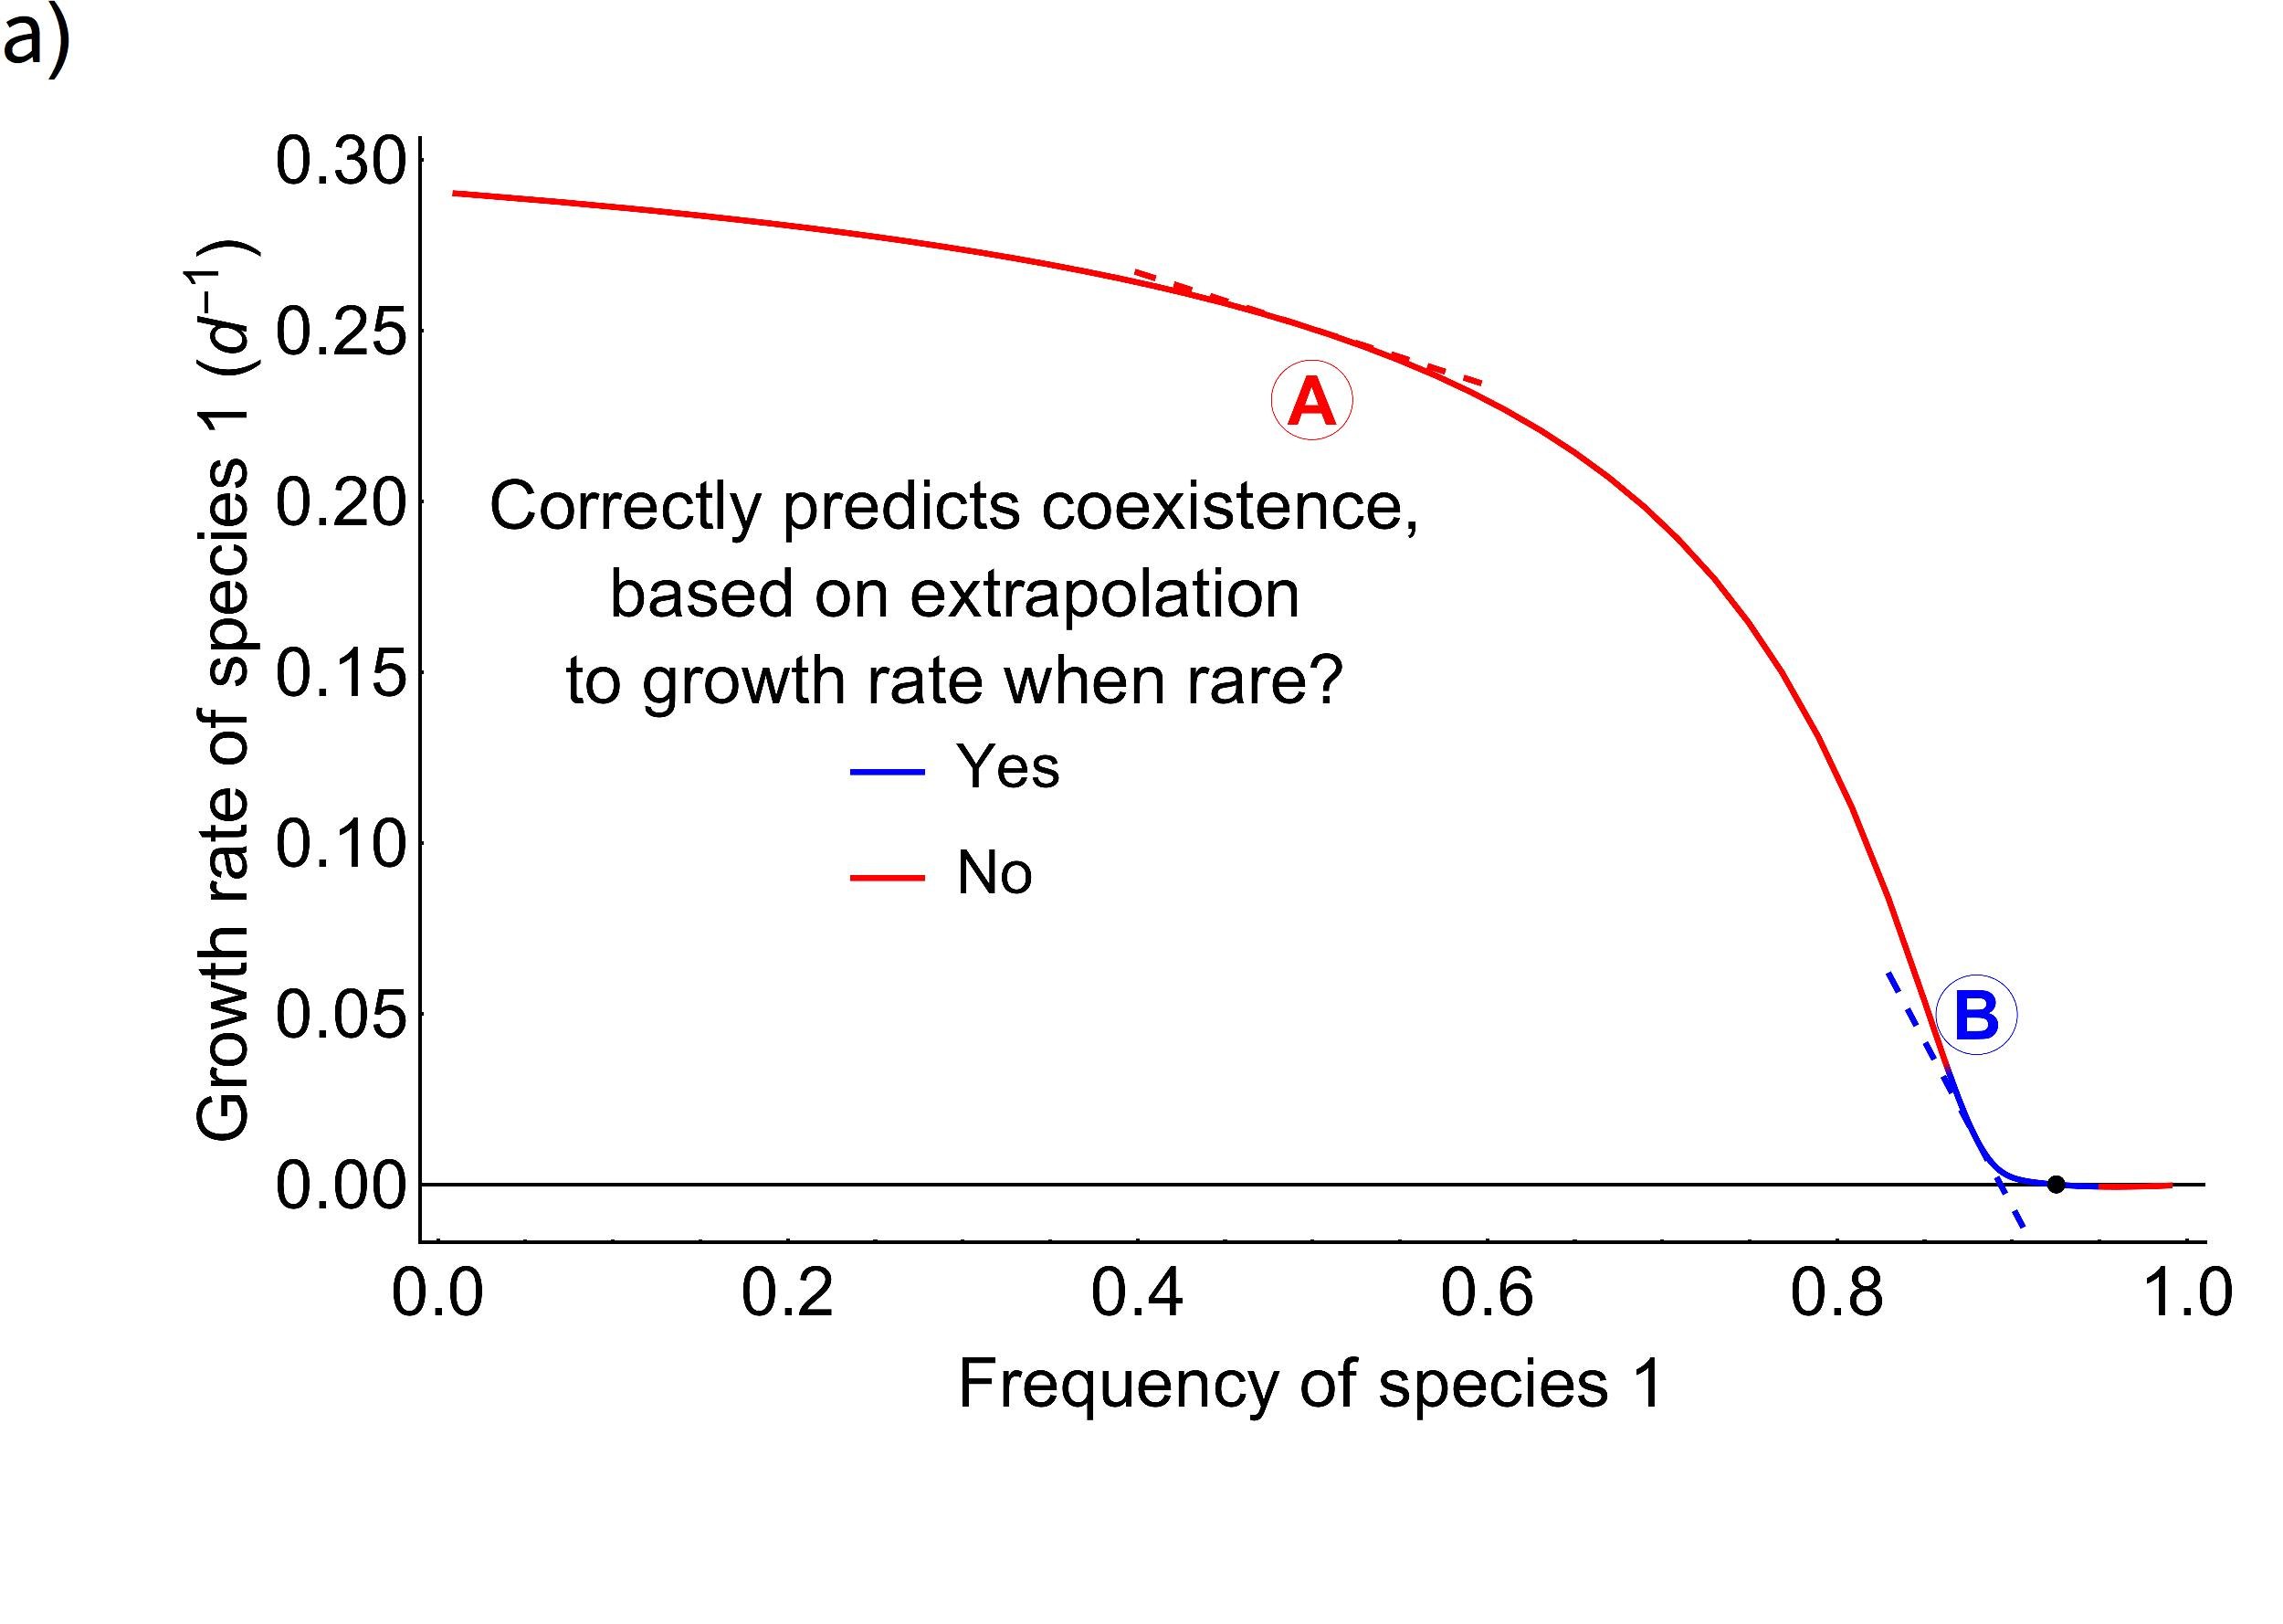
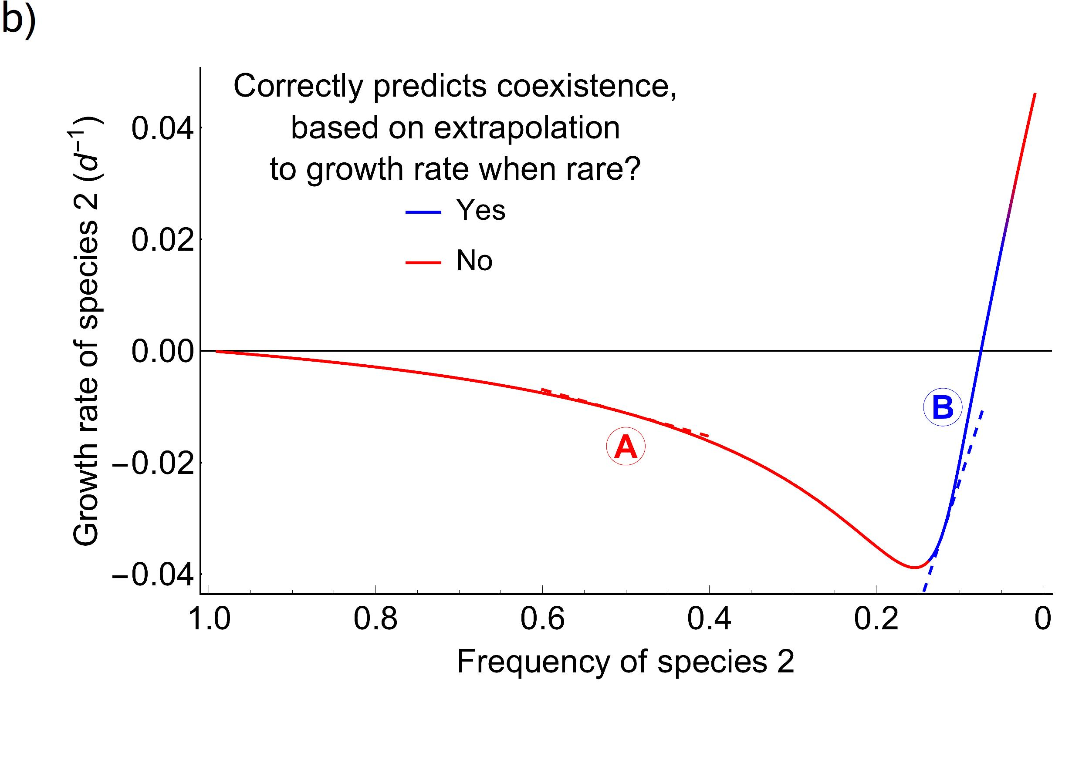
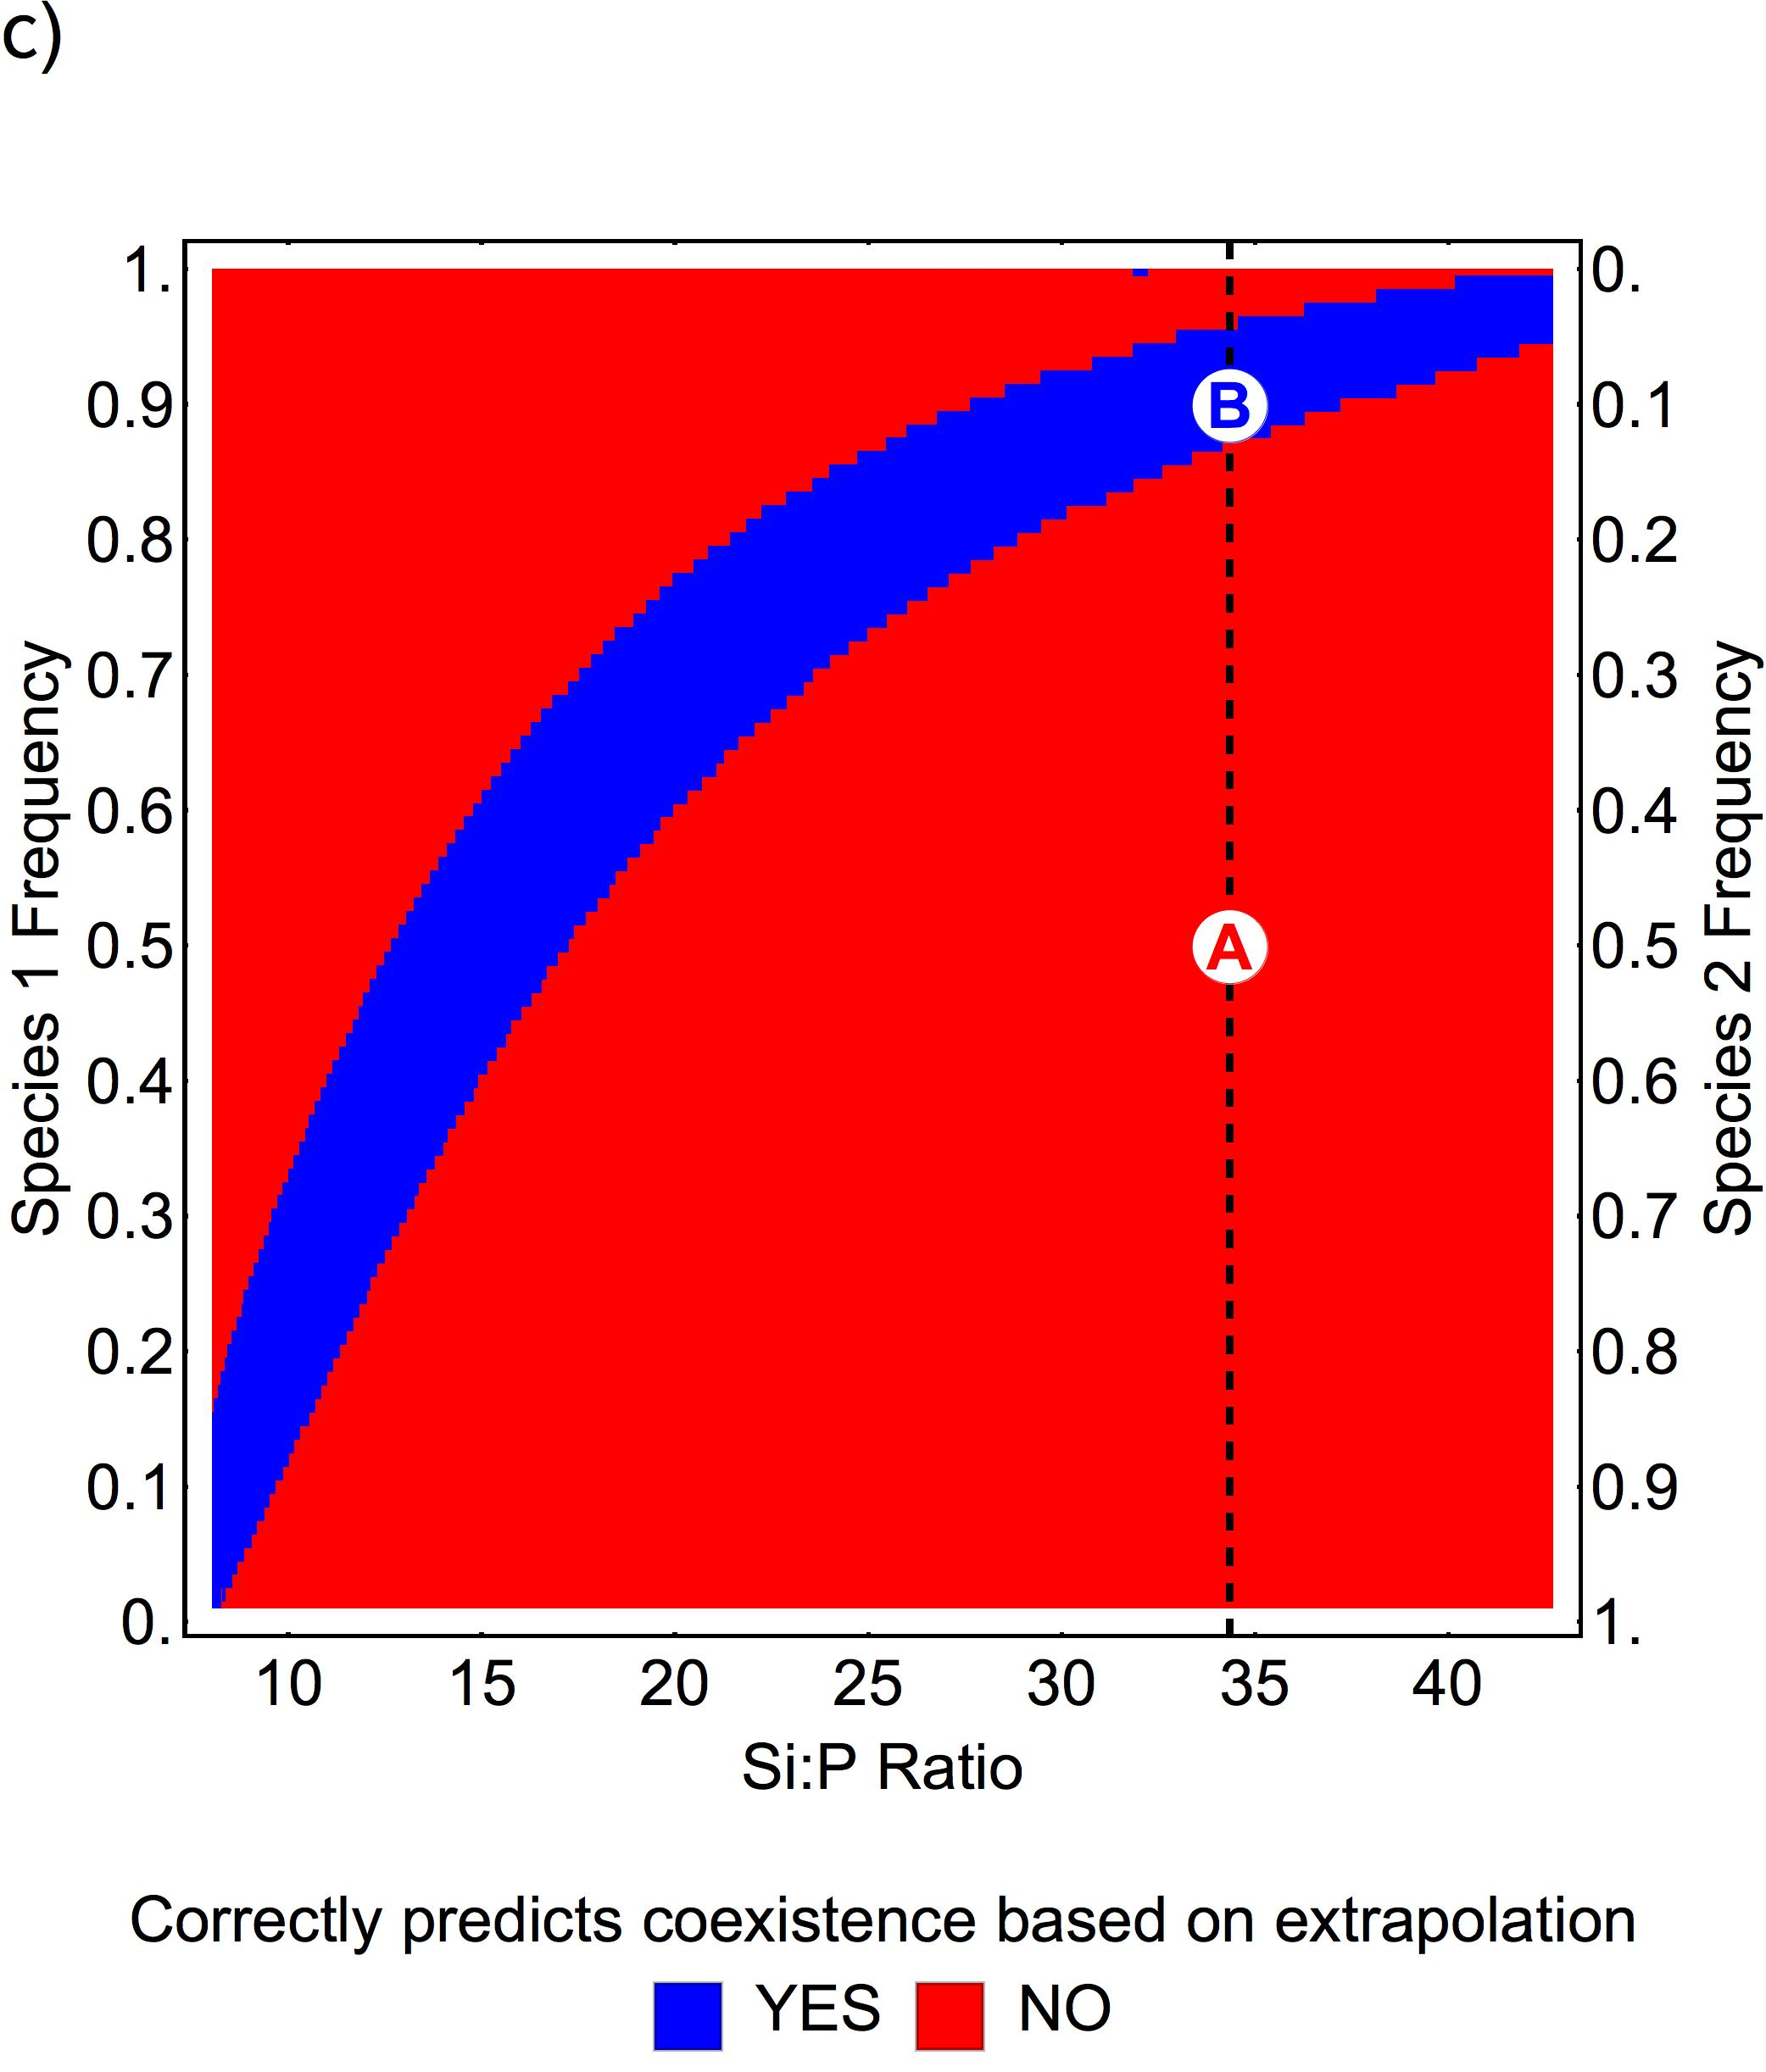

Slide 4
